Slide 1

Config-scripts to kotlin
Presenter: Abdul Ashwood
Date: 02/23/26
Team: Wopr

Slide 2
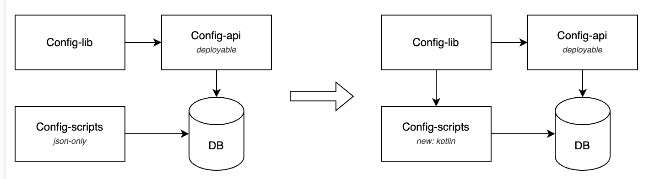
Config structure

Slide 3
JSON-Based Configuration
Negatives (Pain Points)
Weak Validation Model
No compile-time guarantees
Errors surfaced only at runtime
High Risk of Schema Drift
Spelling mistakes in keys
inconsistent field usage
Data Type Mismatches
Implicit casting or runtime mapping failures
Fragile mapping to strongly typed data models
Reviewer Burden
Manual verification of correctness
Hard to enforce team standards systematically
.
Positives
Version Agnostic
JSON not coupled to a specific library/domain version
Multiple config schema variants could coexist
Flexible & Rapid Iteration
No compilation required
Easy to modify and deploy new config structures
Low Barrier to Entry
No strong typing constraints
Simple serialization/deserialization model

Slide 4

Kotlin-Based Implementation
Solves the Issues of Json Implementation
Testable Configuration
Unit tests validate structure and semantics
Automated enforcement of team standards
Reduced Reviewer Cognitive Load
Compiler + tests handle structural validation
Reviewers focus on business logic

Slide 5
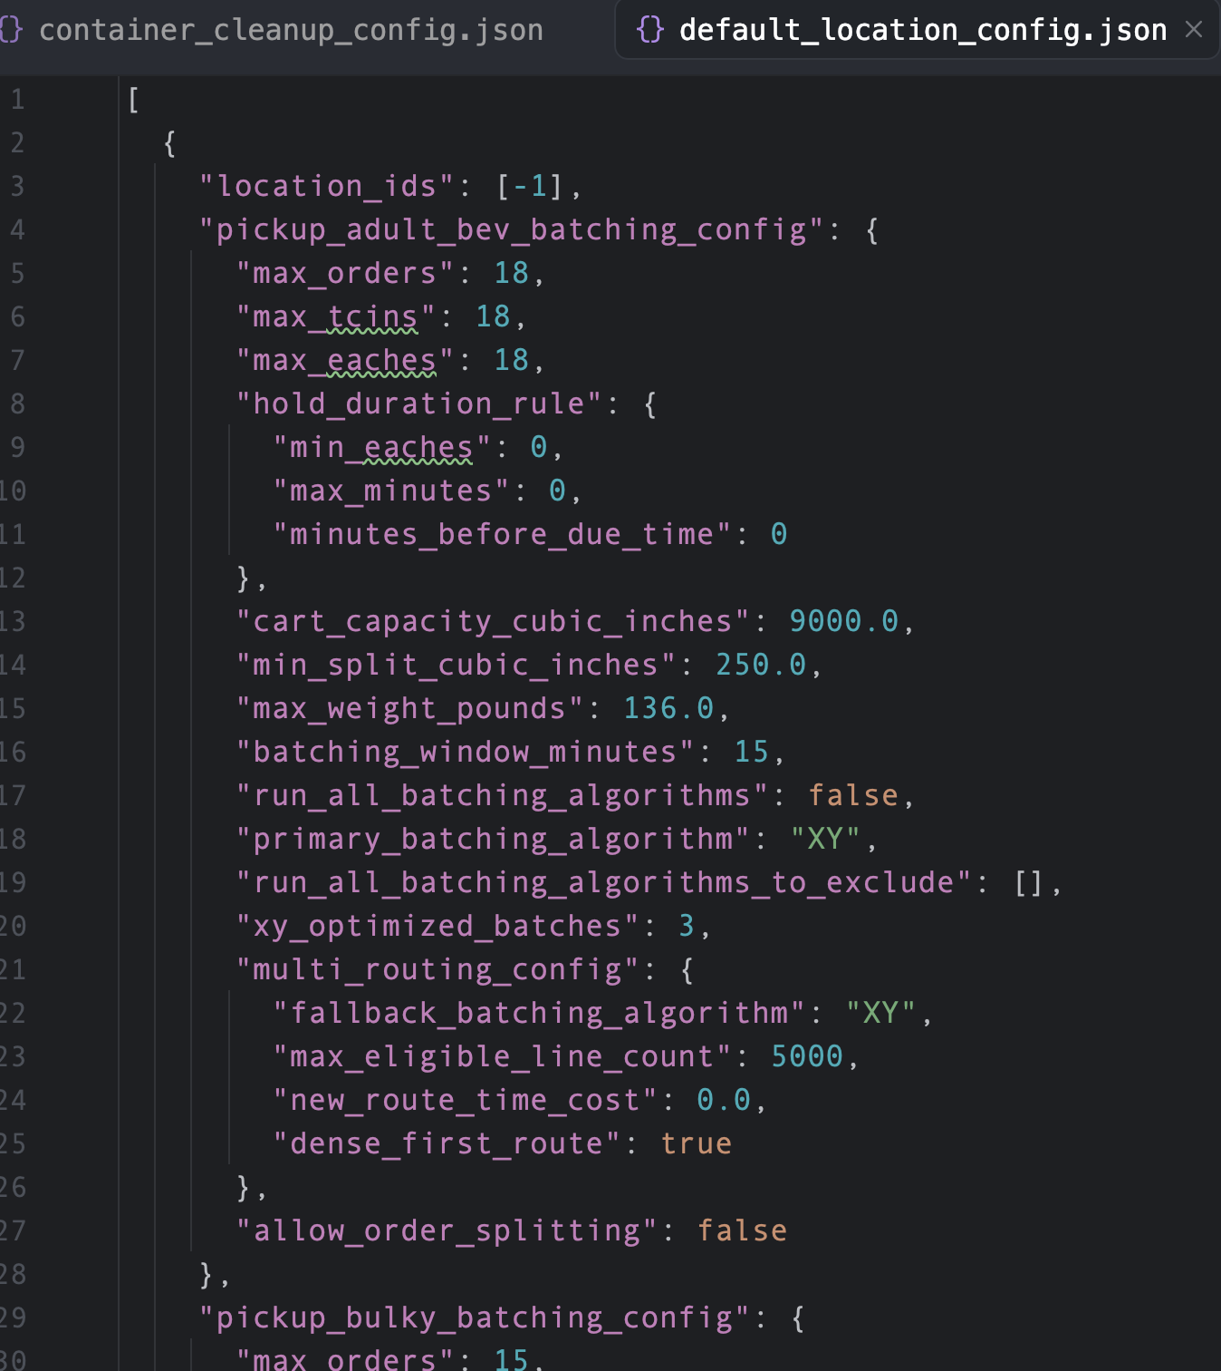
Config as json

Slide 6
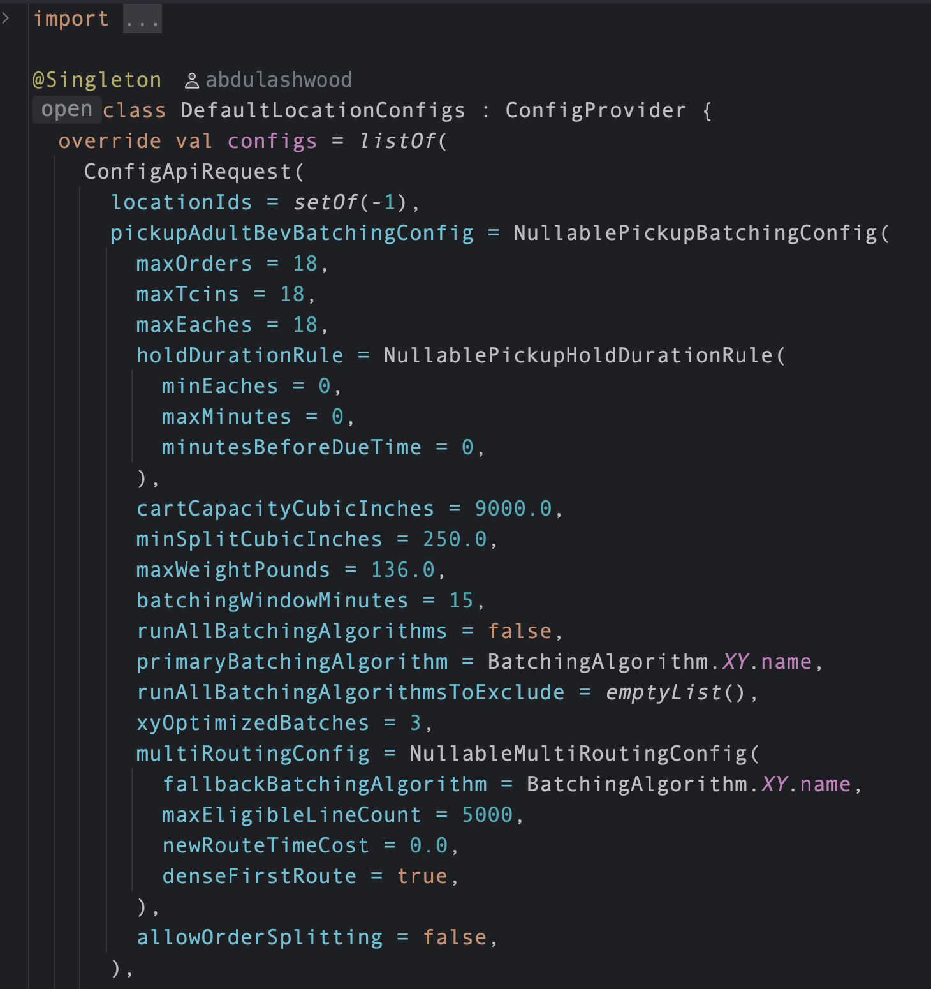
Config as Kotlin

Slide 7
Outcomes
We retained configurational versioning freedom while introducing compiler-enforced schema correctness.

Slide 8

Questions

Slide 9

THANK YOU
Presenter: Abdul Ashwood
Email: tt-wopr@target.com

